Slide 1
The Physical Layer Chapter 2
Theoretical Basis for Data Communications
Guided Transmission Media
Wireless Transmission
Communication Satellites
Digital Modulation and Multiplexing
Public Switched Telephone Network
Mobile Telephone System
Cable Television
Revised: August 2011
Notes:
Gray units can be optionally omitted without causing later gaps

Slide 2
The Physical Layer
Foundation on which other layers build
Properties of wires, fiber, wireless limit what the network can do
Key problem is to send (digital) bits using only (analog) signals
This is called modulation
Application
Transport
Network
Link
Physical

Slide 3
Theoretical Basis for Data Communication
Communication rates have fundamental limits
Fourier analysis »
Bandwidth-limited signals »
Maximum data rate of a channel »

Slide 4
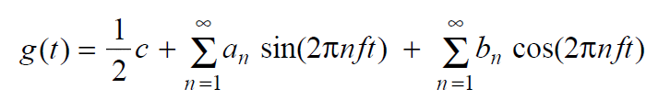
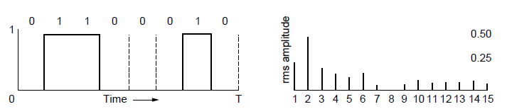
Fourier Analysis
A time-varying signal can be equivalently represented as a series of frequency components (harmonics):
=
Signal over time
a, b weights of harmonics

Slide 5
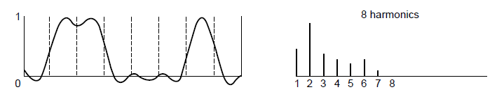
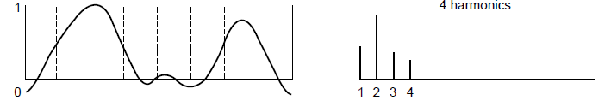
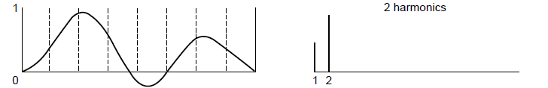
Bandwidth-Limited Signals
Having less bandwidth (harmonics) degrades the signal
8 harmonics
Lost!
Bandwidth
4 harmonics
Lost!
2 harmonics
Lost!

Slide 6
Maximum Data Rate of a Channel
Nyquist’s theorem relates the data rate to the bandwidth (B) and number of signal levels (V):
Shannon's theorem relates the data rate to the bandwidth (B) and signal strength (S) relative to the noise (N):
Max. data rate = 2B log₂V bits/sec
Max. data rate = B log₂(1 + S/N) bits/sec
How fast signal
can change
How many levels
can be seen
Notes:
These are fundamental limits; real systems can only approach them.
S/N is called the signal to noise ratio SNR, and it is commonly measured in decibels on a logarithmic scale e.g., 10dB means the signal is 10X noise, 20dB means 100X noise, etc.

Slide 7
Guided Transmission (Wires & Fiber)
Media have different properties, hence performance
Reality check
Storage media »
Wires:
Twisted pairs »
Coaxial cable »
Power lines »
Fiber cables »

Slide 8
Reality Check: Storage media
Send data on tape / disk / DVD for a high bandwidth link
Mail one box with 1000 800GB tapes (6400 Tbit)
Takes one day to send (86,400 secs)
Data rate is 70 Gbps.
Data rate is faster than long-distance networks!
But, the message delay is very poor.

Slide 9
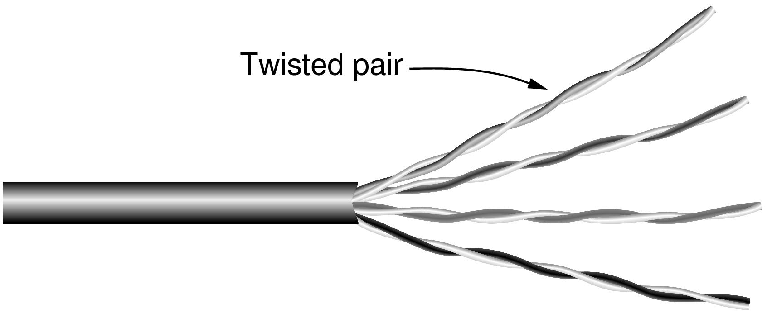
Wires – Twisted Pair
Very common; used in LANs, telephone lines
Twists reduce radiated signal (interference)
Category 5 UTP cable with four twisted pairs
Notes:
This is the garden variety cable used in most offices, e.g., as gigabit Ethernet cables. It is also the old-fashioned telephone line that reaches into your home. The twists reduce interference because the signal radiated from the wire at one location is largely canceled by the signal from the nearby twist; tighter twisting gives higher quality wires. UTP = unshielded twisted pair. STP = shielded twisted pair does exist to shield the wire from external noise for more demanding uses (higher data rates) but is it more expensive and difficult to work with.

Slide 10
Link Terminology
Full-duplex link
Used for transmission in both directions at once
e.g., use different twisted pairs for each direction
Half-duplex link
Both directions, but not at the same time
e.g., senders take turns on a wireless channel
Simplex link
Only one fixed direction at all times; not common

Slide 11
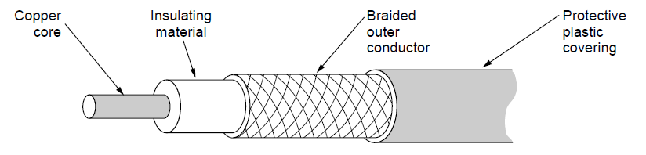
Wires – Coaxial Cable (“Co-ax”)
Also common. Better shielding and more bandwidth for longer distances and higher rates than twisted pair.
Notes:
A higher quality cable than UTP that can carry data at higher rates for longer distances, but is usually more expensive. Enclosing one wire within another provides better immunity to electrical noise. Commonly used for video, e.g., cable TV, because it needs larger bandwidth.

Slide 12
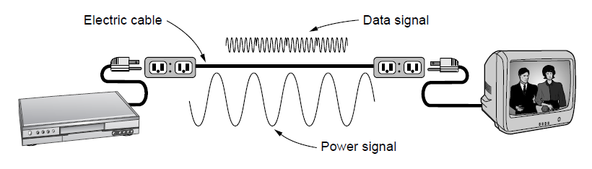
Wires – Power Lines
Household electrical wiring is another example of wires
Convenient to use, but horrible for sending data
Notes:
It is horrible because it carries power signals at the same time and the wiring was not designed for data communications, e.g., it is not tightly twisted like twisted pair, and its electrical properties change as devices that are plugged in turn on and off. But it is convenient because it is already installed and many devices are plugged in to get power, so people are starting to use it.

Slide 13
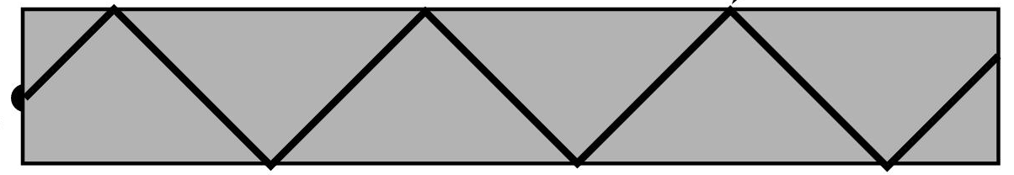


Fiber Cables (1)
Common for high rates and long distances
Long distance ISP links, Fiber-to-the-Home
Light carried in very long, thin strand of glass
Light source
(LED, laser)
Light trapped by
total internal reflection
Photodetector
Notes:
The other main kind of guided media is optical fiber. It is widely used for links that run at high rates, particularly over long distances. It is much, much better than wire in both regards. Examples include the backbone links between ISP facilities, and fiber runs to the home (FTTH) that provide much higher bandwidth home connectivity than ADSL. The optical fiber is a very long, thin strand of glass. The figure shows the overall system. A light source is needed to produce pulses of light, either a LED or a laser (better quality, more expensive). The pulses of light are trapped in the fiber (total internal reflection) and follow it. At the other end a photodetector turns pulses of light into electrical signals.

Slide 14
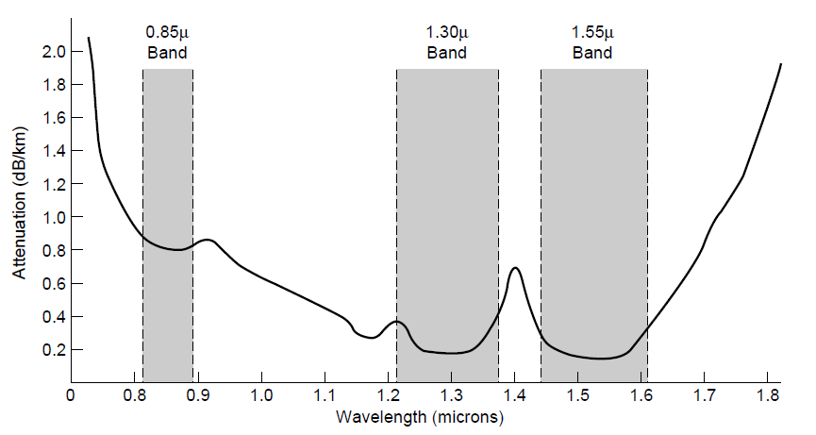
Fiber Cables (2)
Fiber has enormous bandwidth (THz) and tiny signal loss – hence high rates over long distances
Notes:
This slide shows why fiber runs for high rates and long distances – attenuation is very low (can go 10km before the signal has lost 3dB or half its power) for enormous regions of bandwidth (30 *Terahertz* when wavelength is converted to frequency).

Slide 15
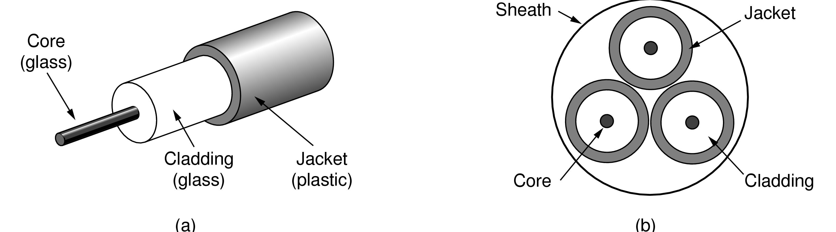
Fiber Cables (3)
Single-mode
Core so narrow (10um) light can’t even bounce around
Used with lasers for long distances, e.g., 100km
Multi-mode
Other main type of fiber
Light can bounce (50um core)
Used with LEDs for cheaper, shorter distance links
Fibers in a cable

Slide 16
Fiber Cables (4)
Comparison of the properties of wires and fiber:
Property | Wires | Fiber
Distance | Short (100s of m) | Long (tens of km)
Bandwidth | Moderate | Very High
Cost | Inexpensive | Less cheap
Convenience | Easy to use | Less easy
Security | Easy to tap | Hard to tap
Notes:
Fiber gives you very high rates over long runs; wires score less highly on these properties and support high rates over much shorter runs. But wires are usually the inexpensive solution when the transmission/reception hardware is included. Wires are also easier to work with; fiber requires greater care with connections. Fiber has the advantage that it is very hard to tap as the light is confined only to the fiber or the fiber is broken. Wires are usually easy to tap because they radiate the signal well.

Slide 17
Wireless Transmission
Electromagnetic Spectrum »
Radio Transmission »
Microwave Transmission »
Light Transmission »
Wireless vs. Wires/Fiber »

Slide 18
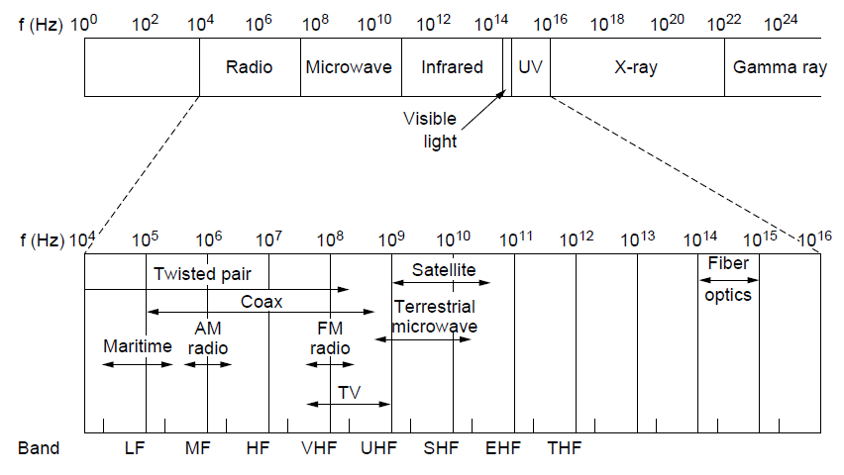
Electromagnetic Spectrum (1)
Different bands have different uses:
Radio: wide-area broadcast; Infrared/Light: line-of-sight
Microwave: LANs and 3G/4G;
Networking focus
Microwave

Slide 19
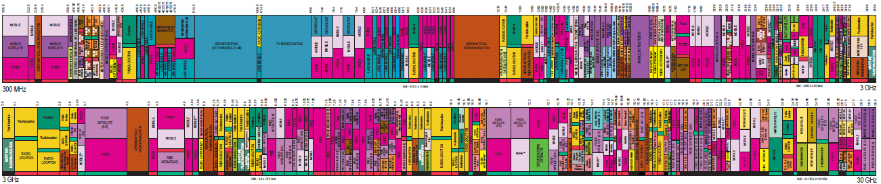
Electromagnetic Spectrum (2)
To manage interference, spectrum is carefully divided, and its use regulated and licensed, e.g., sold at auction.
300 MHz
3 GHz
WiFi (ISM bands)
3 GHz
Source: NTIA Office of Spectrum Management, 2003
30 GHz
Part of the US frequency allocations
Notes:
TV, cellular, satellite frequencies are heavily regulated.

Slide 20
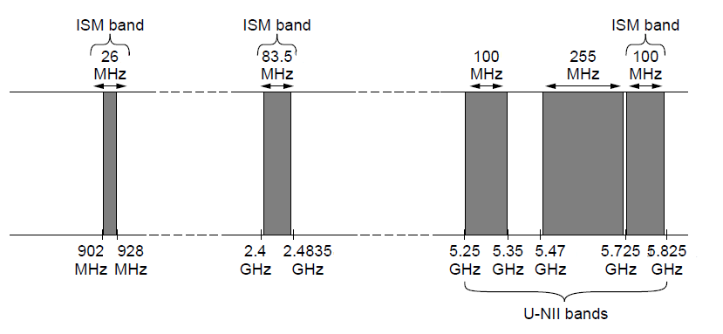
Electromagnetic Spectrum (3)
Fortunately, there are also unlicensed (“ISM”) bands:
Free for use at low power; devices manage interference
Widely used for networking; WiFi, Bluetooth, Zigbee, etc.
802.11
b/g/n
802.11a/g/n
Notes:
These bands are used for WiFi, etc., not for cellular.

Slide 21
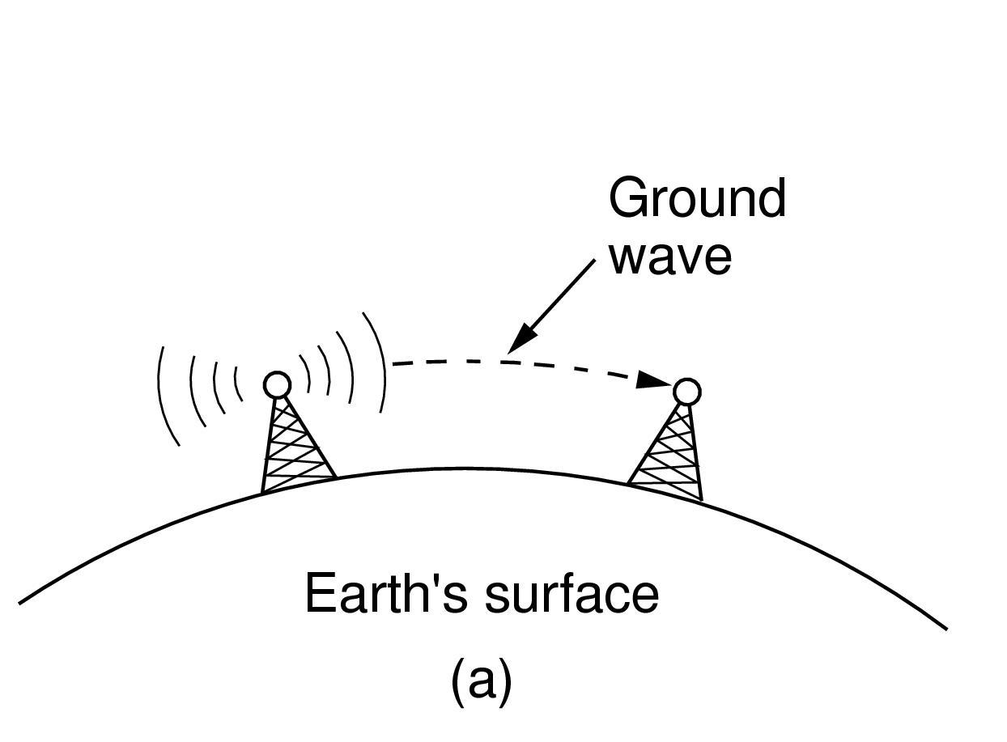
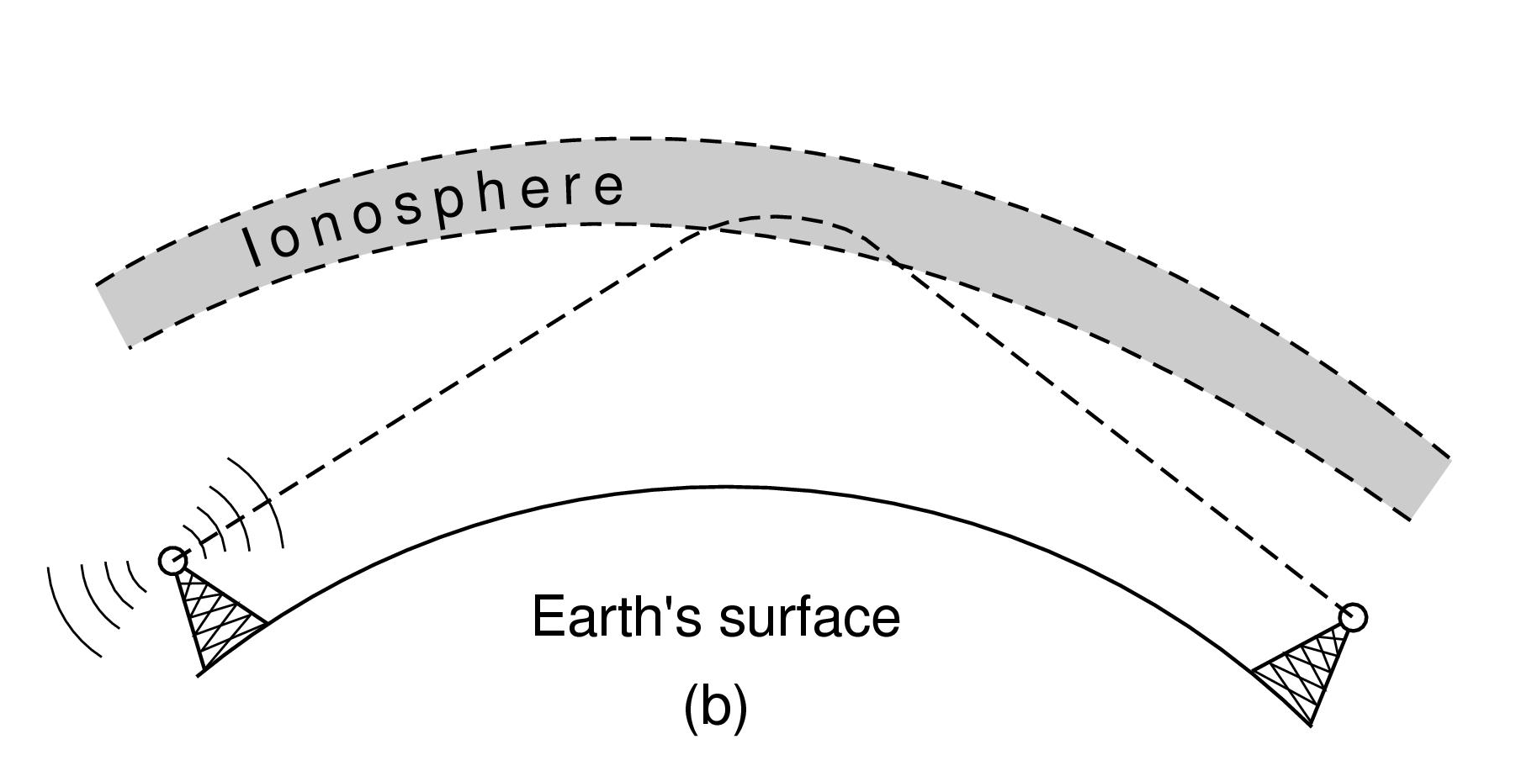
Radio Transmission
Radio signals penetrate buildings well and propagate for long distances with path loss
In the VLF, LF, and MF bands, radio waves follow the curvature of the earth
In the HF band, radio waves bounce off the ionosphere.
Notes:
The path loss makes the signal fall of at least as fast as 1/d^2 due to the RF energy being spread out over a greater region.

Slide 22
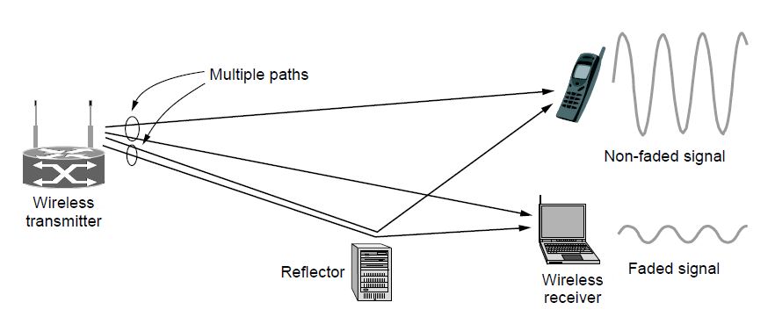
Microwave Transmission
Microwaves have much bandwidth and are widely used indoors (WiFi) and outdoors (3G, satellites)
Signal is attenuated/reflected by everyday objects
Strength varies with mobility due multipath fading, etc.
Notes:
The variation in signal strength as the sender/receiver move is a key hallmark of wireless. It means that data rates over wireless links can change dramatically; they are not fixed like a wire.

Slide 23

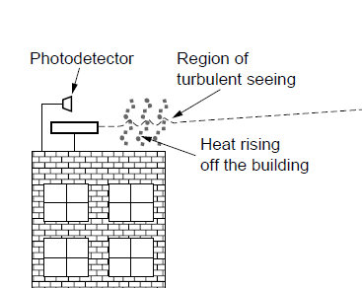
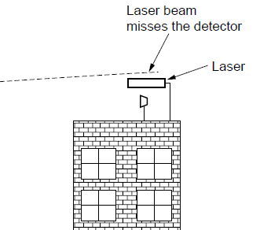
Light Transmission
Line-of-sight light (no fiber) can be used for links
Light is highly directional, has much bandwidth
Use of LEDs/cameras and lasers/photodetectors

Slide 24
Wireless vs. Wires/Fiber
Wireless:
Easy and inexpensive to deploy
Naturally supports mobility
Naturally supports broadcast
Transmissions interfere and must be managed
Signal strengths hence data rates vary greatly
Wires/Fiber:
Easy to engineer a fixed data rate over point-to-point links
Can be expensive to deploy, esp. over distances
Doesn’t readily support mobility or broadcast

Slide 25
Communication Satellites
Satellites are effective for broadcast distribution and anywhere/anytime communications
Kinds of Satellites »
Geostationary (GEO) Satellites »
Low-Earth Orbit (LEO) Satellites »
Satellites vs. Fiber »

Slide 26
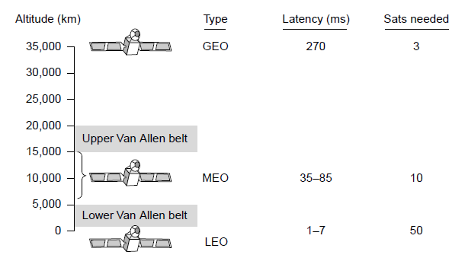
Kinds of Satellites
Satellites and their properties vary by altitude:
Geostationary (GEO), Medium-Earth Orbit (MEO), and Low-Earth Orbit (LEO)
Sats needed for global coverage
Notes:
MEO is used for navigation systems such as the GPS (Global Positioning System) rather than data communications.

Slide 27
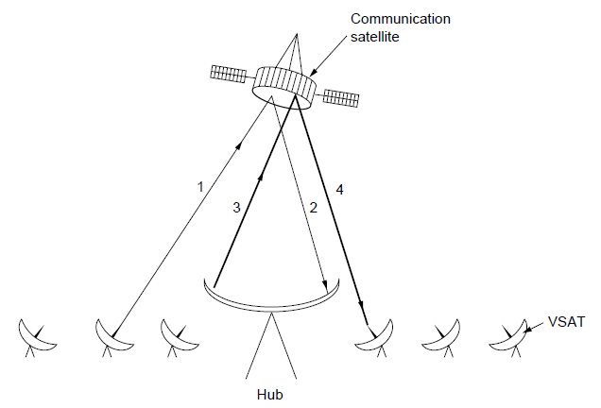
Geostationary Satellites
GEO satellites orbit 35,000 km above a fixed location
VSAT (computers) can communicate with the help of a hub
Different bands (L, S, C, Ku, Ka) in the GHz are in use but may be crowded or susceptible to rain.
GEO satellite
VSAT

Slide 28
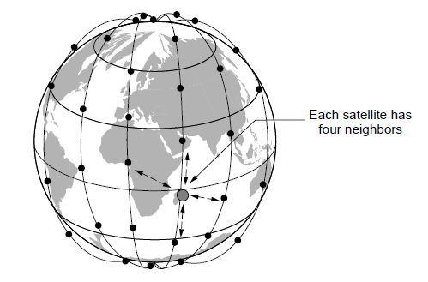
Low-Earth Orbit Satellites
Systems such as Iridium use many low-latency satellites for coverage and route communications via them
The Iridium satellites form six necklaces around the earth.
Notes:
Since the satellites are LEO, it does not take long for signals from the Earth to go up and down compared to GEO satellites.

Slide 29
Satellite vs. Fiber
Satellite:
Can rapidly set up anywhere/anytime communications (after satellites have been launched)
Can broadcast to large regions
Limited bandwidth and interference to manage
Fiber:
Enormous bandwidth over long distances
Installation can be more expensive/difficult

Slide 30
Digital Modulation and Multiplexing
Modulation schemes send bits as signals; multiplexing schemes share a channel among users.
Baseband Transmission »
Passband Transmission »
Frequency Division Multiplexing »
Time Division Multiplexing »
Code Division Multiple Access »

Slide 31
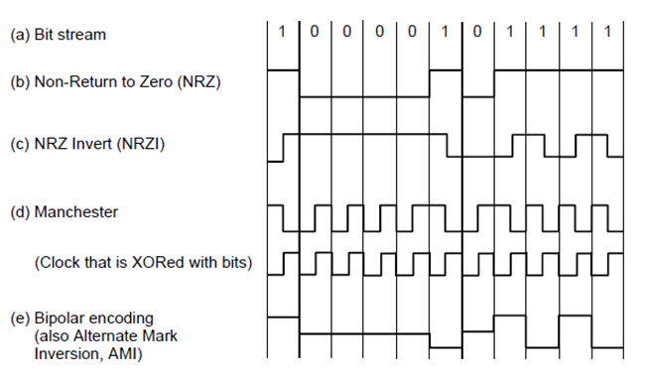
Baseband Transmission
Line codes send symbols that represent one or more bits
NRZ is the simplest, literal line code (+1V=“1”, -1V=“0”)
Other codes tradeoff bandwidth and signal transitions
Four different line codes

Slide 32
Clock Recovery
To decode the symbols, signals need sufficient transitions
Otherwise long runs of 0s (or 1s) are confusing, e.g.:
Strategies:
Manchester coding, mixes clock signal in every symbol
4B/5B maps 4 data bits to 5 coded bits with 1s and 0s:
Scrambler XORs tx/rx data with pseudorandom bits
1
0 0 0 0 0 0 0 0 0 0 um, 0? er, 0?
Data | Code | Data | Code | Data | Code | Data | Code
0000 | 11110 | 0100 | 01010 | 1000 | 10010 | 1100 | 11010
0001 | 01001 | 0101 | 01011 | 1001 | 10011 | 1101 | 11011
0010 | 10100 | 0110 | 01110 | 1010 | 10110 | 1110 | 11100
0011 | 10101 | 0111 | 01111 | 1011 | 10111 | 1111 | 11101
Notes:
Strategies go from simplest to more complex and make progressively better use of bandwidth:
-Manchester is simple (every symbol has an embedded transition) but uses twice the bandwidth of a data signal
-4B/5B ensures no more than three 0s in a row (1s can be handled by making the signal level change to represent a 1) and needs 1.25X bandwidth
-scrambler needs no extra bandwidth (just data XOR sequence XOR sequence = data) but only makes long runs of 0s or 1s a low probability event

Slide 33
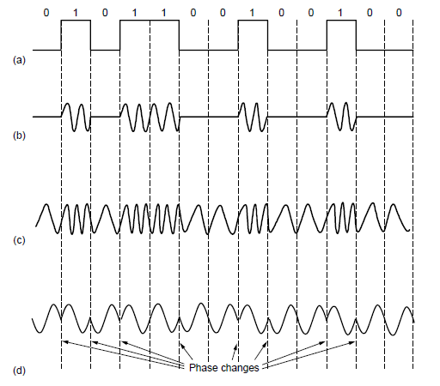
Passband Transmission (1)
Modulating the amplitude, frequency/phase of a carrier signal sends bits in a (non-zero) frequency range
NRZ signal of bits
Amplitude shift keying
Frequency shift keying
Phase shift keying

Slide 34
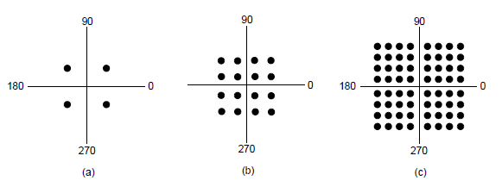
Passband Transmission (2)
Constellation diagrams are a shorthand to capture the amplitude and phase modulations of symbols:
BPSK
2 symbols
1 bit/symbol
QPSK
4 symbols
2 bits/symbol
QAM-16
16 symbols
4 bits/symbol
QAM-64
64 symbols
6 bits/symbol
BPSK/QPSK varies only phase
QAM varies amplitude and phase

Slide 35
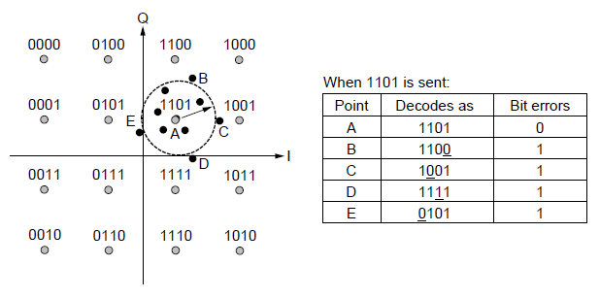
Passband Transmission (3)
Gray-coding assigns bits to symbols so that small symbol errors cause few bit errors:
B
E
A
C
D

Slide 36
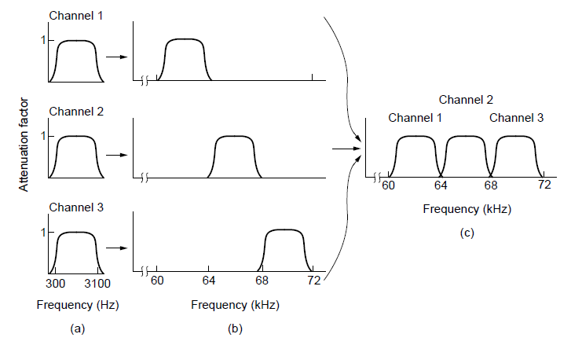
Frequency Division Multiplexing (1)
FDM (Frequency Division Multiplexing) shares the channel by placing users on different frequencies:
Overall FDM channel

Slide 37
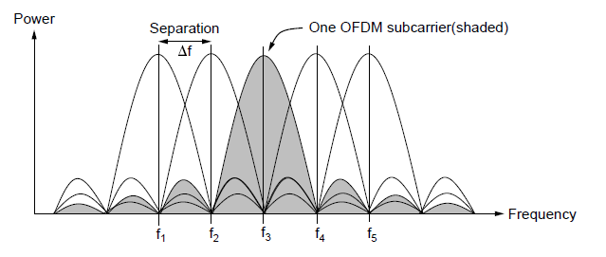
Frequency Division Multiplexing (2)
OFDM (Orthogonal FDM) is an efficient FDM technique used for 802.11, 4G cellular and other communications
Subcarriers are coordinated to be tightly packed

Slide 38
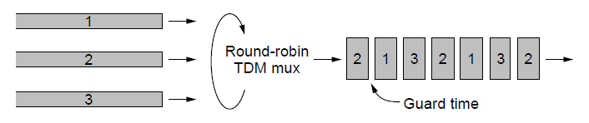
Time Division Multiplexing (TDM)
Time division multiplexing shares a channel over time:
Users take turns on a fixed schedule; this is not packet switching or STDM (Statistical TDM)
Widely used in telephone / cellular systems

Slide 39
Code Division Multiple Access (CDMA)
CDMA shares the channel by giving users a code
Codes are orthogonal; can be sent at the same time
Widely used as part of 3G networks
Sender Codes
Transmitted
Signal
Receiver Decoding
+1
+1
S x A
+2
+2
Sum = 4
A sent “1”
A =
-1
-1
0
0
+2
+1
+1
0
0
Sum = -4
B sent “0”
B =
0
0
S x B
-1
-1
-2
-2
-2
+1
+1
S = +A -B
S x C
+2
Sum = 0
C didn’t send
C =
-1
-1
0
0
-2

Slide 40
The Public Switched Telephone Network
Structure of the telephone system »
Politics of telephones »
Local loop: modems, ADSL, and FTTH »
Trunks and multiplexing »
Switching »

Slide 41
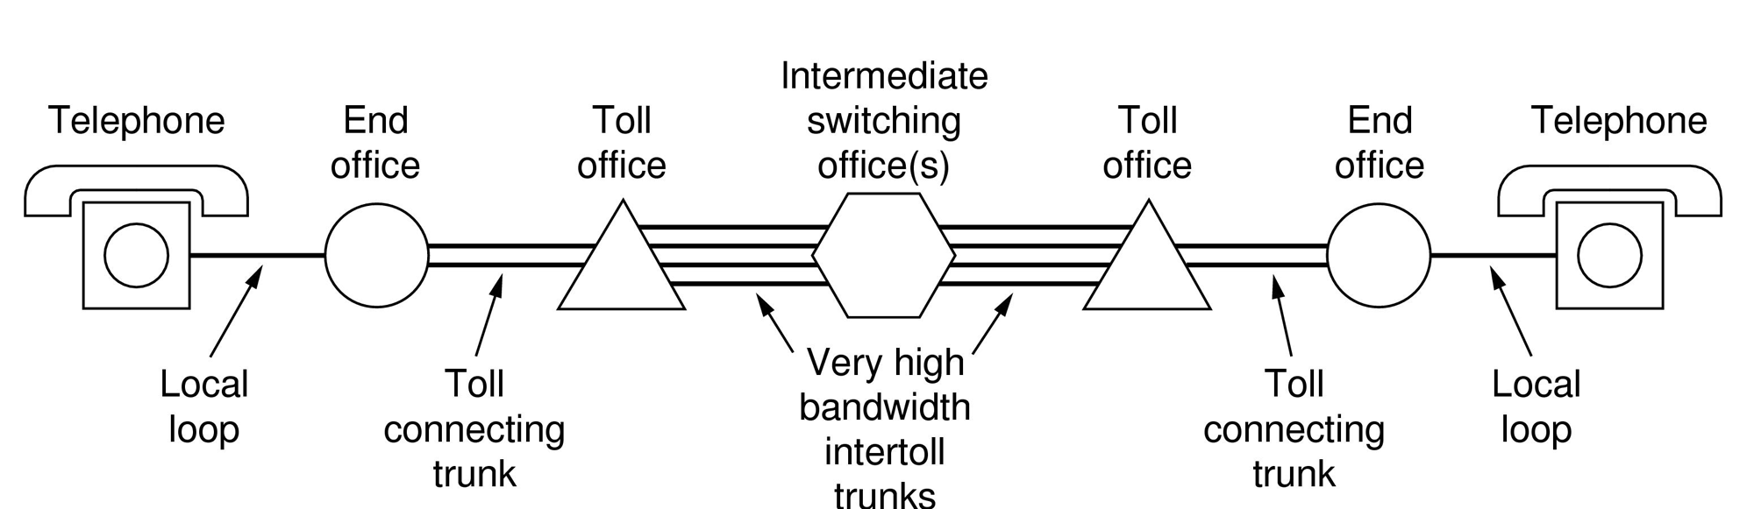
Structure of the Telephone System
A hierarchical system for carrying voice calls made of:
Local loops, mostly analog twisted pairs to houses
Trunks, digital fiber optic links that carry calls
Switching offices, that move calls among trunks

Slide 42
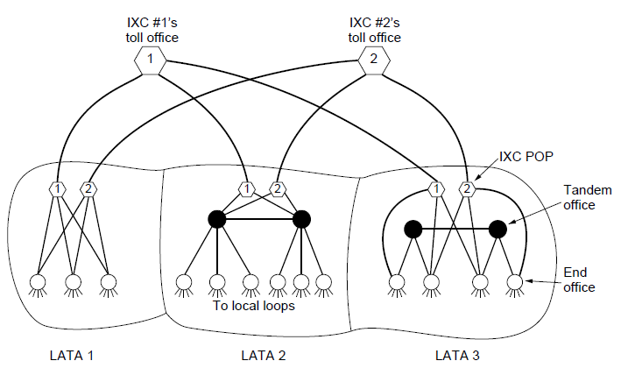
The Politics of Telephones
In the U.S., there is a distinction for competition between serving a local area (LECs) and connecting to a local area (at a POP) to switch calls across areas (IXCs)
Customers of a LEC can dial via any IXC they choose
Notes:
This distinction is to encourage competition by splitting the local and long distance markets. Another regulation to promote competition is local number portability, i.e., you can take your telephone number when you change carriers, to make changing easier.

Slide 43
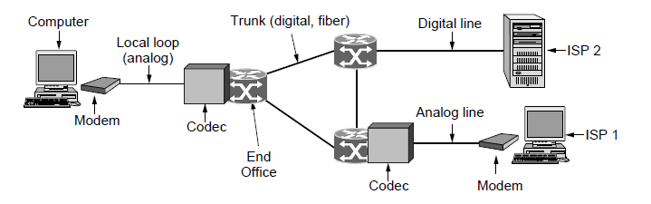
Local loop (1): modems
Telephone modems send digital data over an 3.3 KHz analog voice channel interface to the POTS
Rates <56 kbps; early way to connect to the Internet
Notes:
POTS = plain old telephone network, i.e., the traditional voice calls in the PSTN without modern improvements like DSL.

Slide 44
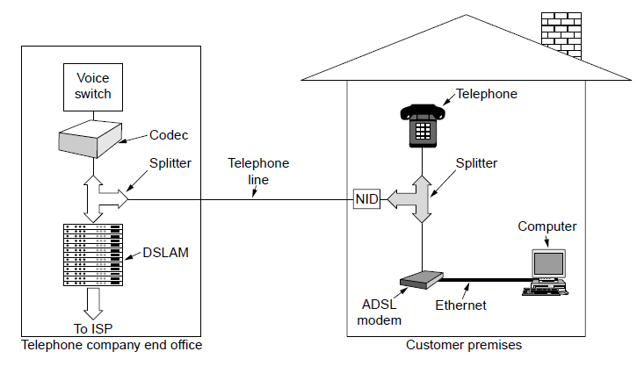
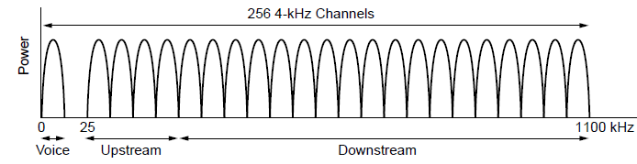
Local loop (2): Digital Subscriber Lines
DSL broadband sends data over the local loop to the local office using frequencies that are not used for POTS
Telephone/computers attach to the same old phone line
Rates vary with line
ADSL2 up to 12 Mbps
OFDM is used up to 1.1 MHz for ADSL2
Most bandwidth down
Notes:
ADSL for “asymmetric DSL” is the most popular version of DSL. The asymmetric means that greater bandwidth hence greater data rates are allocated to downstream traffic.

Slide 45
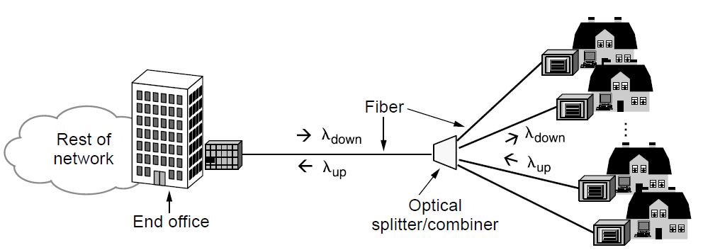
Local loop (3): Fiber To The Home
FTTH broadband relies on deployment of fiber optic cables to provide high data rates customers
One wavelength can be shared among many houses
Fiber is passive (no amplifiers, etc.)

Slide 46
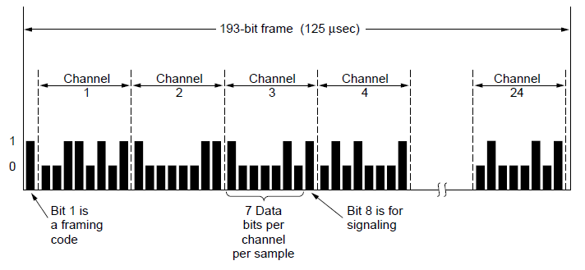
Trunks and Multiplexing (1)
Calls are carried digitally on PSTN trunks using TDM
A call is an 8-bit PCM sample each 125 μs (64 kbps)
Traditional T1 carrier has 24 call channels each 125 μs (1.544 Mbps) with symbols based on AMI

Slide 47
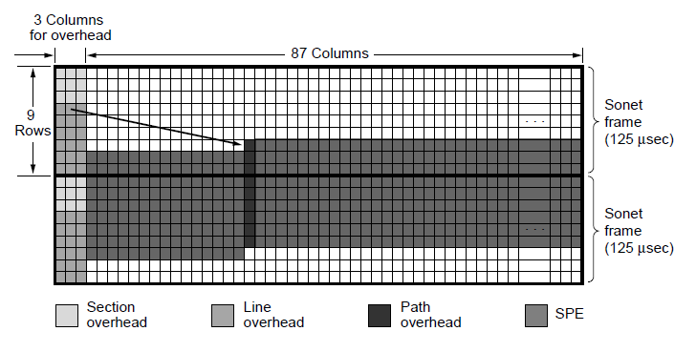
Trunks and Multiplexing (2)
SONET (Synchronous Optical NETwork) is the worldwide standard for carrying digital signals on optical trunks
Keeps 125 μs frame; base frame is 810 bytes (52Mbps)
Payload “floats” within framing for flexibility

Slide 48
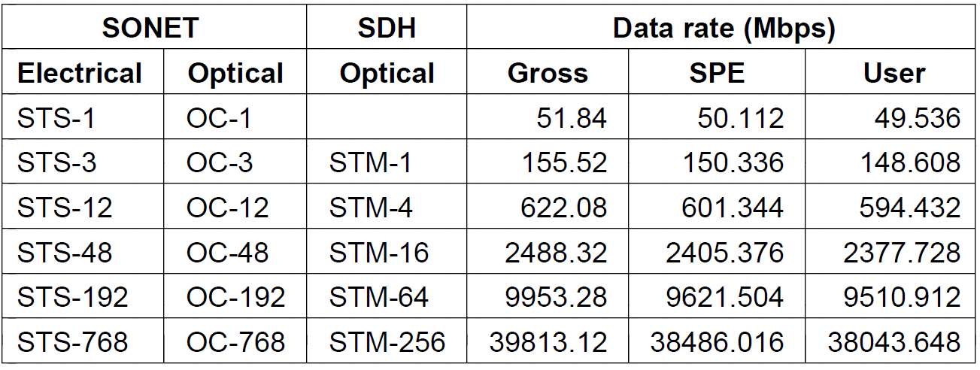
Trunks and Multiplexing (3)
Hierarchy at 3:1 per level is used for higher rates
Each level also adds a small amount of framing
Rates from 50 Mbps (STS-1) to 40 Gbps (STS-768)
SONET/SDH rate hierarchy

Slide 49
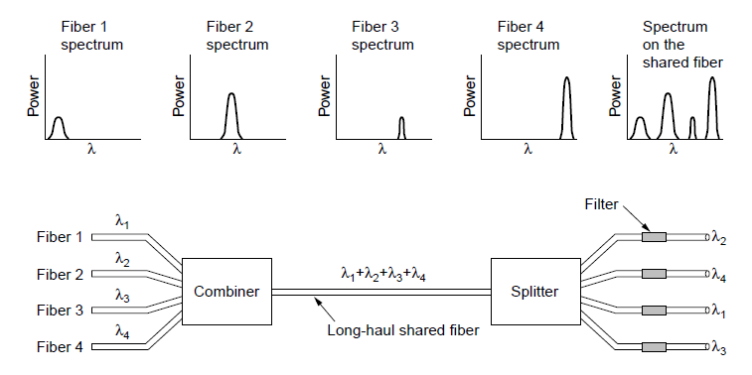
Trunks and Multiplexing (4)
WDM (Wavelength Division Multiplexing), another name for FDM, is used to carry many signals on one fiber:

Slide 50
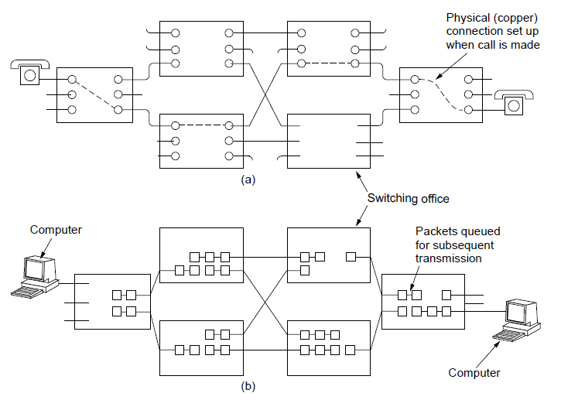
Switching (1)
PSTN uses circuit switching; Internet uses packet switching
PSTN:
Internet:

Slide 51
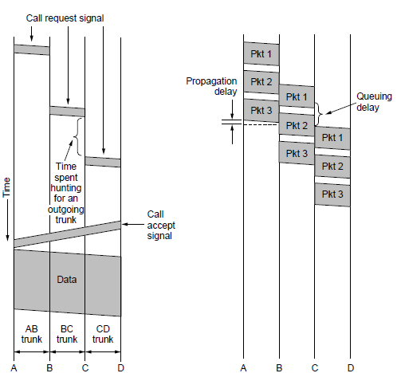
Switching (2)
Circuit switching requires call setup (connection) before data flows smoothly
Also teardown at end (not shown)
Packet switching treats messages independently
No setup, but variable queuing delay at routers
Circuits
Packets

Slide 52
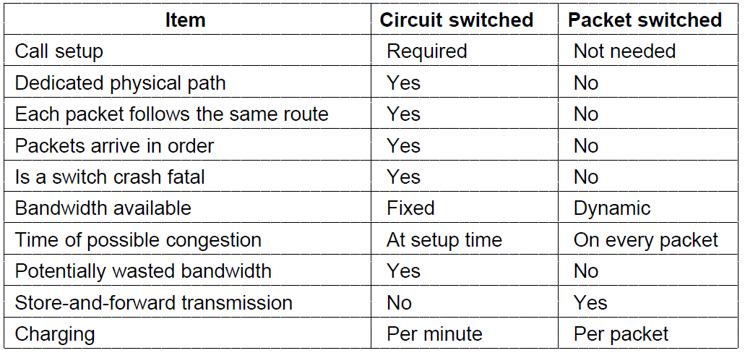
Switching (3)
Comparison of circuit- and packet-switched networks

Slide 53
Mobile Telephone System
Generations of mobile telephone systems »
Cellular mobile telephone systems »
GSM, a 2G system »
UMTS, a 3G system »

Slide 54
Generations of mobile telephone systems
1G, analog voice
AMPS (Advanced Mobile Phone System) is example, deployed from 1980s. Modulation based on FM (as in radio).
2G, analog voice and digital data
GSM (Global System for Mobile communications) is example, deployed from 1990s. Modulation based on QPSK.
3G, digital voice and data
UMTS (Universal Mobile Telecommunications System) is example, deployed from 2000s. Modulation based on CDMA
4G, digital data including voice
LTE (Long Term Evolution) is example, deployed from 2010s. Modulation based on OFDM

Slide 55
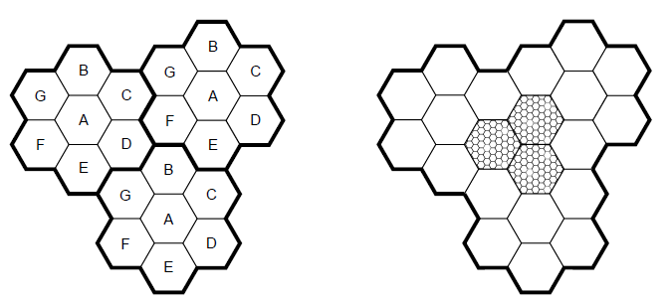
Cellular mobile phone systems
All based on notion of spatial regions called cells
Each mobile uses a frequency in a cell; moves cause handoff
Frequencies are reused across non-adjacent cells
To support more mobiles, smaller cells can be used
Cellular reuse pattern
Smaller cells for dense mobiles

Slide 56
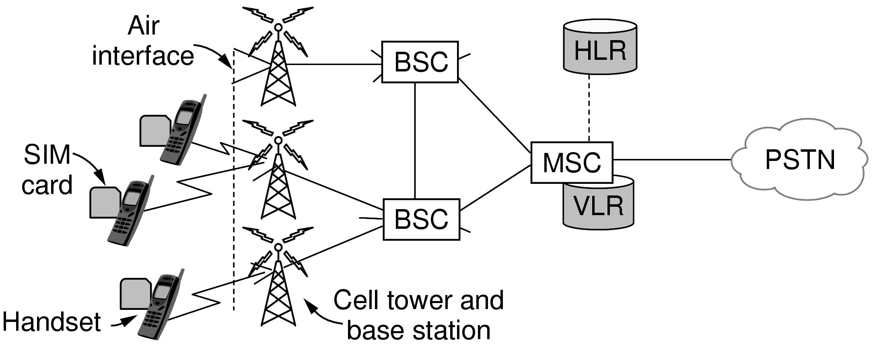
GSM – Global System for Mobile Communications (1)
Mobile is divided into handset and SIM card (Subscriber Identity Module) with credentials
Mobiles tell their HLR (Home Location Register) their current whereabouts for incoming calls
Cells keep track of visiting mobiles (in the Visitor LR)

Slide 57
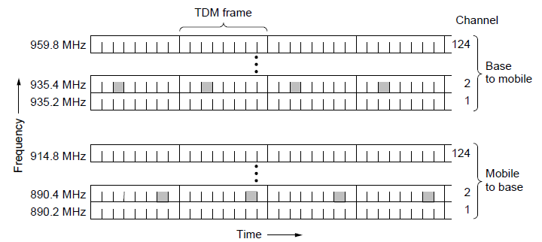
GSM – Global System for Mobile Communications (2)
Air interface is based on FDM channels of 200 KHz divided in an eight-slot TDM frame every 4.615 ms
Mobile is assigned up- and down-stream slots to use
Each slot is 148 bits long, gives rate of 27.4 kbps
Notes:
GSM runs mostly in 850 / 900 / 1800 / 1900 MHz spectrum depending on the country

Slide 58
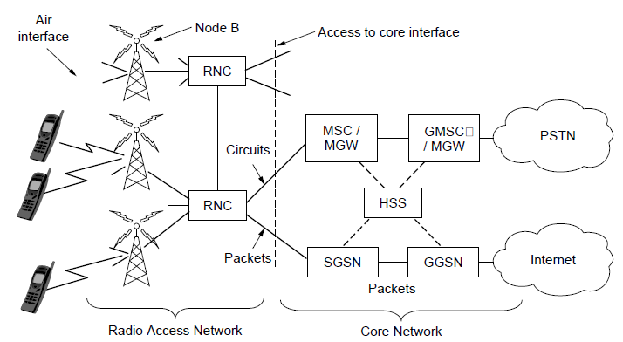
UMTS – Universal Mobile Telecommunications System (1)
Architecture is an evolution of GSM; terminology differs
Packets goes to/from the Internet via SGSN/GGSN
Internet

Slide 59
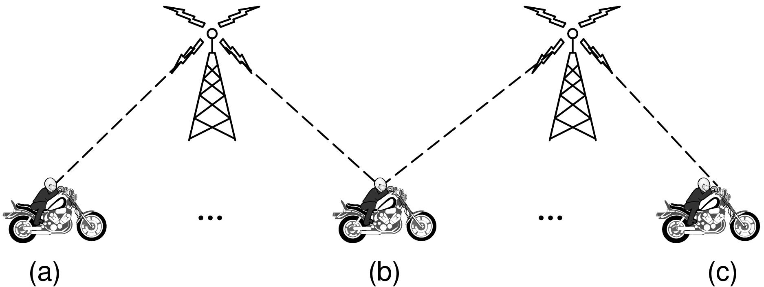
UMTS – Universal Mobile Telecommunications System (2)
Air interface based on CDMA over 5 MHz channels
Rates over users <14.4 Mbps (HSPDA) per 5 MHz
CDMA allows frequency reuse over all cells
CDMA permits soft handoff (connected to both cells)
Soft
handoff

Slide 60
Cable Television
Internet over cable »
Spectrum allocation »
Cable modems »
ADSL vs. cable »

Slide 61
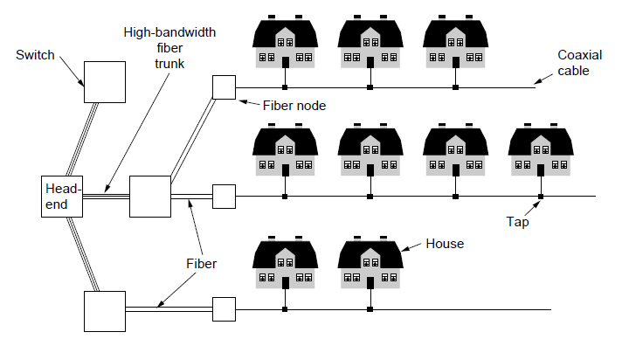
Internet over Cable
Internet over cable reuses the cable television plant
Data is sent on the shared cable tree from the head-end, not on a dedicated line per subscriber (DSL)
ISP
(Internet)

Slide 62
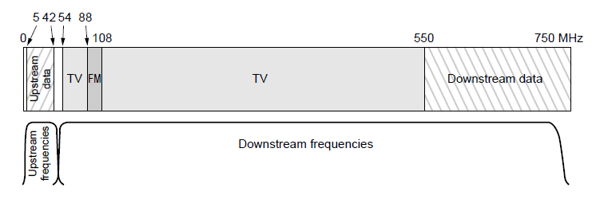
Spectrum Allocation
Upstream and downstream data are allocated to frequency channels not used for TV channels:

Slide 63
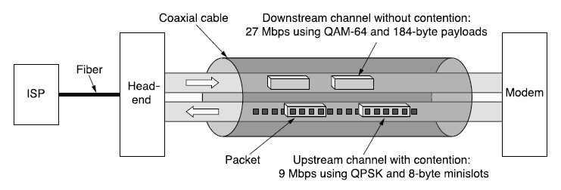
Cable Modems
Cable modems at customer premises implement the physical layer of the DOCSIS standard
QPSK/QAM is used in timeslots on frequencies that are assigned for upstream/downstream data

Slide 64
Cable vs. ADSL
Cable:
Uses coaxial cable to customers (good bandwidth)
Data is broadcast to all customers (less secure)
Bandwidth is shared over customers so may vary
ADSL:
Bandwidth is dedicated for each customer
Point-to-point link does not broadcast data
Uses twisted pair to customers (lower bandwidth)

Slide 65
End
Chapter 2

